Slide 1
Compliance and Peer Reviews
IRP Peer Reviews

Slide 2
Peer Review Program – WHAT?
A “Peer Review” is a review of the jurisdiction’s compliance with the Plan and Audit Procedures Manual (APM).
The IRP Board approved Compliance Guide must be used for each review.
The Peer Review Committee is also responsible for the Annual Fee Test (Section 1225).

Slide 3
Peer Review Program
Peer review opening conference.
Peer review closing conference.
Final report/jurisdiction response.
Peer review follow-up.

Slide 4
IRP Peer Review Team
Peer reviews are conducted by a review team from the Peer Review Committee (from the jurisdiction’s region when possible), consisting of:
One (1) administrative representative;
One (1) audit representative; and
One (1) IRP staff representative

Slide 5
Ballot 371
Ballot changes effective July 1, 2013.
Multiple forms of education was provided on the changes affecting Inadequate Records.
Record Reviews.
Compliance guide changes that allows review both pre and post audits sample audits.

Slide 6
Ballot 400
Effective January 1, 2016
Primary Changes
  Reference to Estimated Distance was removed from the Plan.
  Combined APM Sections 504 and 505 to refer to auditing actual distance.
  Clarification that properly reported APVD distance is not auditable

Slide 7
Top IRP Findings
Section 1055, Audit Reports
  Jurisdiction is not submitting the Interjurisdictional audit reports to affected jurisdictions at the time the registrant audit report is sent with the base jurisdiction’s customary notification which signifies the beginning of the registrant’s appeal period
Section 1025, Frequency of Audits
  Jurisdiction did not complete audits equivalent to an average of 3% per year.

Slide 8
Top IRP Findings
Section 1050 – Netting Audit Adjustments
  Jurisdiction does not consistently transmit the appropriate fees changes to the affected member jurisdictions with 30 calendar days following the transmittal period during which the collection was made.
Section APM 601 - Audit Report
  Required information not included

Slide 9

IRP Jurisdictions for review in 2016
Connecticut
District of Columbia
Florida
Idaho
Maryland
Minnesota
Oklahoma
South Dakota
Tennessee
Utah
Virginia

Slide 10
Peer Review Program
The 2016 Peer Review Committee members are:
Region I – Bruce Bierbaum (VT) & Neal Boehmer (MD)
Region II – Alton Roane (GA) & Troy Thigpen (AL)
Region III – Davin Greeno (MO) – Vice Chair & Tiffany Meltzer (IN)

Slide 11
Peer Review Program
Region IV –& Jerri Hunter (ID) Chair, Michelle Schober (NV) &Betsy McCabe (NV) Past Chair
Canadian Representative – Charito MacKay (BC)
At Large (US) – Linda Lunschen (WA)
Board Liaison – Jeff Hood (IN)
IRP Staff Liaison – Ken Carey

Slide 12
IRP Peer Review Contact Information
Ken Carey,
Phone: (703) 963-1604
E-mail: kcarey@irpinc.org
(Coordinators of the reviews can confirm what is expected, information requested/received and corroborate time frames during the review period.)

Slide 13
IFTA Ballot #3-2014 Changes
Presented by:
Richard Wagner, Chair
IFTA Program Compliance Review Committee

Slide 14
IFTA Ballot #3-2014 Changes
Presented by:
Richard Wagner, Chair
IFTA Program Compliance Review Committee
Debora K. Meise, Senior Director
IFTA, Inc.

Slide 15
IFTA Ballot #3-2014 Changes
The word “Should” now indicates a requirement… unless a relevant, documented reason exists to not comply.
“Must” and “Shall” are still requirements.

Slide 16
IFTA Ballot #3-2014 Changes
The Effective Date is January 1, 2017.
Each audit will now require better planning as well as more detailed documentation in the audit file for various steps throughout the audit process.
Several areas of the amended Audit Manual include:

Slide 17
A240 Auditor Qualifications
A240.200 Auditors should conduct themselves in a manner promoting cooperation and good relations with licensees and member jurisdictions

Slide 18
A240 Auditor Qualifications
A240.400 Each member jurisdiction must ensure its auditors maintain proficiency in IFTA auditing by providing training opportunities through internal or external training sources.

Slide 19
A240 Auditor Qualifications
What does this mean?
Jurisdictions will need to maintain information on training received by auditors.
IFTA/IRP Audit Workshop becomes an even more valuable tool to give your audit staff required training opportunities!

Slide 20
A320 Evaluation of Internal Controls
- The auditor must provide a summary description of the licensee’s distance and fuel accounting systems.
- The auditor should compare the distance and fuel summaries provided by the licensee to the tax return, and document any differences.
- An example of the licensee’s records examined by the auditor should be included in the audit file.

Slide 21
A310 Preliminary Audit Procedures
A310.100 …must identify, and document…vehicles operated…and vehicle characteristics that might affect the audit.
A310.300 …must analyze…tax returns…, note trends or variances, and document findings in the audit file.

Slide 22
A310 Preliminary Audit Procedures
What does this mean?
Complete equipment lists with details of vehicles operated required.
A documented review of tax returns is required.

Slide 23
A320 Evaluation of Internal Controls
A320.600 When sampling, the reliability of the licensee’s internal controls should determine the degree to which the records are tested.

Slide 24
A320 Evaluation of Internal Controls
What does it mean?
The final amount of records tested / sampled is to be determined after evaluating internal controls.

Slide 25
A360 Reduction to Total Fuel
The total fuel reported by a licensee shall only be reduced when there is clear proof, based on the records provided by the licensee, to support such a reduction and such proof is documented in the audit file. The absence of tax paid fuel receipts and a subsequent denial of tax-pad credits claimed does not, in and of itself, warrant a reduction to reported total gallons.

Slide 26
A360 Reduction to Total Fuel
Although not a should, this is a major point.
Document and comment on why there are reductions in total fuel.
Without documentation and comments by auditor, a reduction will mean non-compliance!

Slide 27
A420 Notification
A420.100 The licensee should be contacted at least 30 days prior to the conduct of an audit. Through the initial or subsequent audit contacts, the licensee must be advised of the audit period, the type of records to be audited, and the proposed audit start date.

Slide 28
A420 Notification
Although a should, this mirrors what already occurs.

Slide 29
A440 Opening Conference
A documented opening conference should be held with the licensee to discuss the licensee’s operations, distance and fuel accounting system, audit procedures, records to be examined, sample period, sampling procedures, etc.

Slide 30
A440 Opening Conference
What does this mean?
It is suggested a standardized form be created for auditors to use. The ideal form will include check boxes and places for comments to be made.
It is also recommended to include a place for the licensee to sign that the opening conference occurred.
Save the form inside the audit!

Slide 31
A450 Closing Conference
A documented closing conference should be held with the licensee during which any areas of non-compliance, and any requirements and recommendations for improvement to the distance and accounting systems are discussed.

Slide 32
A450 Closing Conference
What does this mean?
Like with the Opening Conference, a standardized form should be created, used, and signed (if possible).
A450 doesn’t require financial details of the audit to be disclosed during conference.

Slide 33
A460 Audit Report
An audit report, including a narrative and billing summary documenting the audit, must be prepared by the base jurisdiction and provided to the licensee and all affected member jurisdictions. Where appropriate a checklist may serve this purpose. A copy of the audit report must be kept in the audit file.

Slide 34
A460 Audit Report
The base jurisdiction should send the audit report to all affected jurisdictions at the same time it sends the final report to the licensee. The audit report must contain:
.100 General Information
.200 Summary of the Evaluation of Internal Controls
.300 The opening and closing conference…
.400 Sampling Methodology Information
.500 Distance and Fuel Examination
.600 Summary
.700 Billing Summary

Slide 35
A460 Audit Report
What does this mean?
Many jurisdictions will need to significantly overhaul their audit report and also change the distribution date to the member jurisdictions.
Carefully review all requirements to make sure your jurisdiction’s Audit Report complies with A460!

Slide 36
Suggestions
Document, document, document.
Create an activity log and require thorough entries by auditors.
Make sure supporting documents are kept as well as supervisor / auditor discussions.
Completely review Audit Manual to make sure your jurisdiction is compliant!

Slide 37
PCRC’s Work Ahead
In March, the PCRC is having a Face to Face meeting at the IFTA World Headquarters.
The primary task during this meeting is to update the Review Guide and Worksheets that are currently used during the PCR’s to reflect the changes made in Ballot #3-2014.

Slide 38


Audit Language Changes
That was then…
This is Now!

Slide 41
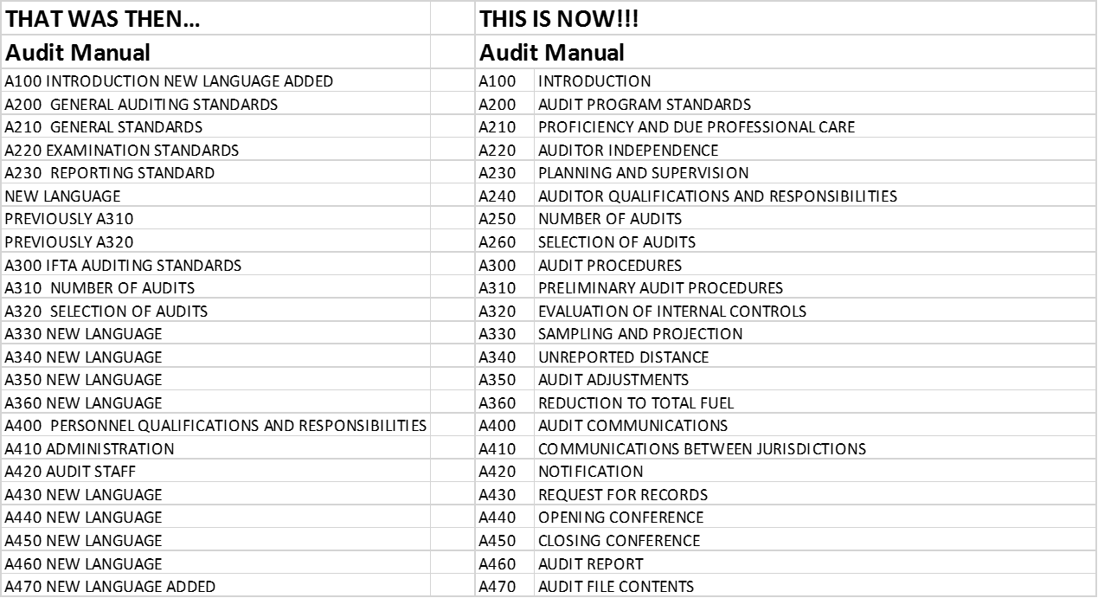

Slide 42
S
T
R
I
C
KEN
LANGUAGE

Slide 43
Where can I find this list of changes?
Check out the IFTA, Inc. website following the March 8-10, 2016 PCRC meeting @
www.iftach.org

